Slide 1

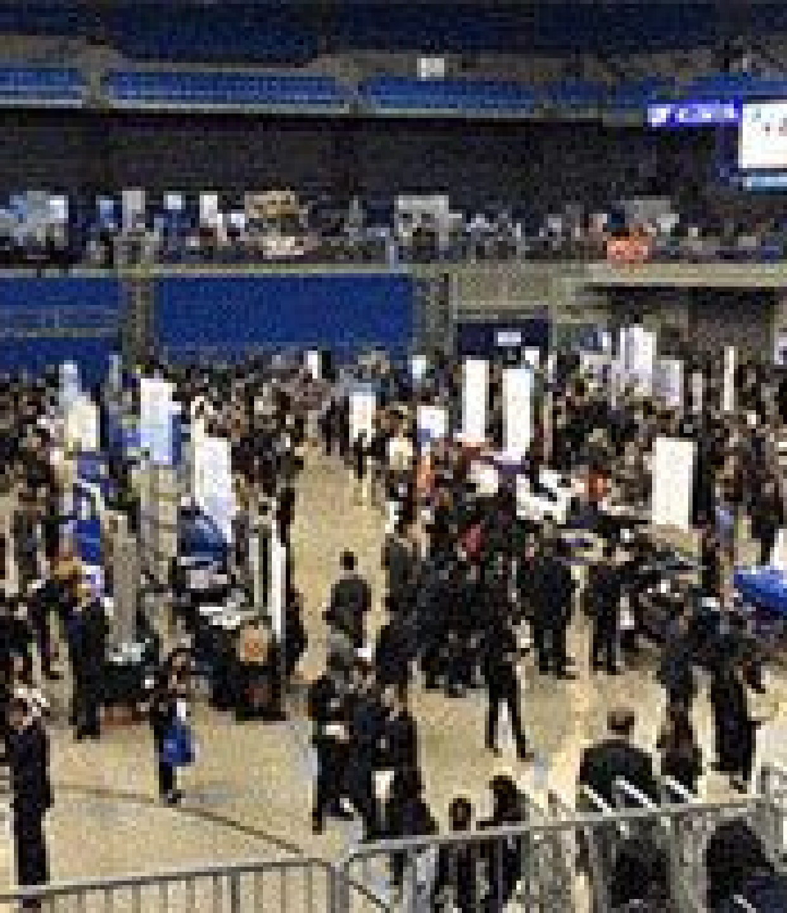
JOB UTSOB
An all-DIU Recruitment Fest

Slide 2


JOB UTSOB
IDEATION & PRESENTATION BY
K M Hassan Ripon, Mentor, Employability 360, DIU
UNLOCK THE BORDER OF
OPPORTUNITIES
Prof Ujjwal K Chowdhury, Strategic Adviser & Professor Daffodil International University

Slide 3

JOB UTSOB
Time: First half of December for 4 days: December 01 to 04, 2022 (Thursday to Saturday)
Multi-dimensional Human Resource & Recruitment Initiative

Slide 4

JOB UTSOB
Nature of the Fest
NATIONAL
HR LEADER’S SPEAK
Venue:
International conference room
Nature of Event:
Senior HR leaders of various addressing the students on their organizations, recruitment trends, talent needs, and skills-set they seek
Run-down:
ONE company ONE hour on prior booking:
9am till 6pm, on all days, with one hour lunch break. 50 speakers this way from 50 leading companies
Knowledge Series.

Slide 5
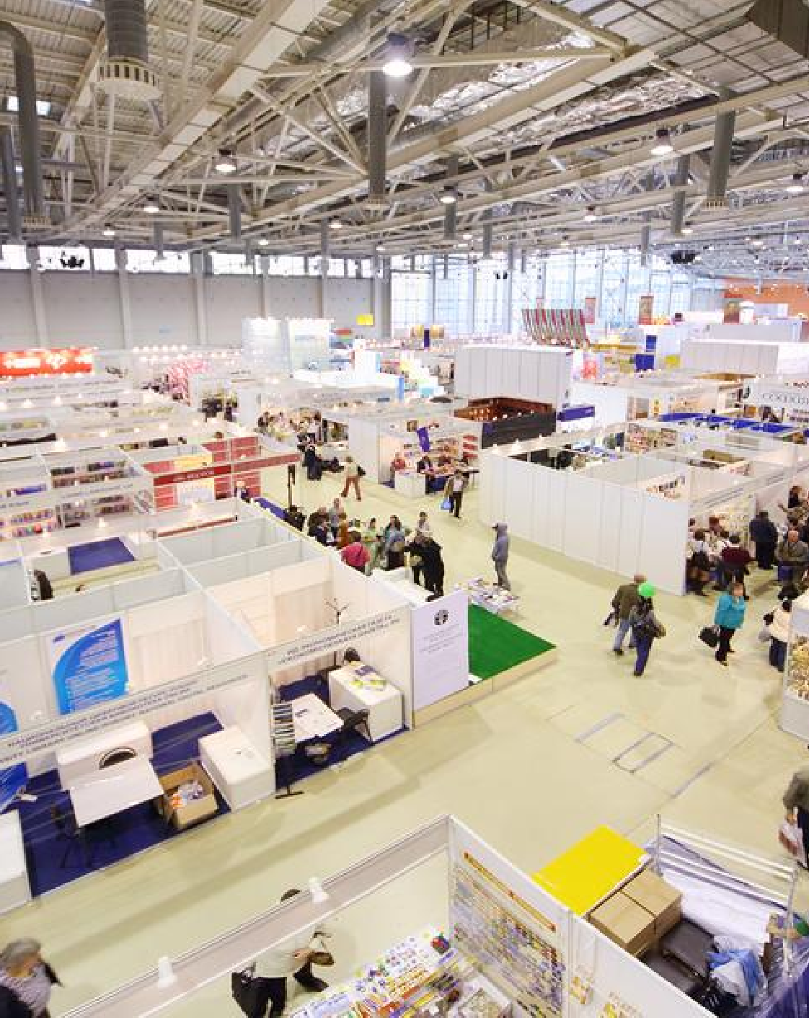
200 BOOTHS ACROSS THE CAMPUS
Nature of Event:
Youths to talk to the companies representatives about their companies briefly, the entry level needs, and share insights, flyers
200 companies and large NGOs and government enterprises. Brand Series.
JOB UTSOB
Nature of the Fest

Slide 6

JOB UTSOB
Nature of the Fest
INTERVIEWS
Some 150 companies to conduct interviews in 150+ rooms
Entry to mid-level recruitments
Those passing out this year or upto five years of experience
The last 10 to 12 batches of last 5 years
This will be ideally based on earlier shortlisting of CVs Recruitment Series.

Slide 7

NATURE OF PREPARATION
400-500 companies during June to August, 2022
September to November, 2022, for 90 days: each day at least one HR Manager for a session with the students in the mini conference hall
Each speaker will have a faculty and a student responsible
150+ companies for recruitment to send a brief ppt on the JDs
Final Year Students & Alumni giving names to get these JDs in November, 2022, for their better preparation.
Total CVs for recruitment should be at least around 4000.
JOB UTSOB

Slide 8
NATURE OF PREPARATION (CONTD..)
December 01-04, 2022: 200 booths, one seminar hall, 150 rooms for interviews: one student responsible for each of these.
Tie up with a business paper for an HR series out of the 50 seminars
Tie-up with a business focused YouTube channel/ television channel, for 15 minutes video interviews of each of the 50 stalwart speakers.
100 stories for The Paramount, 50 Campus TV stories, 20 stories for Campus Radio: Various types
Selection and on-boarding process finalized in advance
Each of the 150+ recruiters shall have a minimum target of 10 recruitments (maximum whatever)
At least 2000+ actual jobs being created: minimum 1 out of every 2 applicants
Appointments to be offered before December 31, 2022.

Slide 9
SPONSORSHIPS
Cosmetic brands
HR
Consulting
TARGET
BDT 10-15 lacs sponsorship
Telecom & Handset Brands
International Manpower Consulting
They will get a stall, 20,000 on campus attendance, and a minimum 5000 database of passing out students and alumni
Youth focused Bike brand
Commercial Bank
Concept Note
ALPINE SKI

Slide 10

OUTCOMES
2000 actual jobs (at least 25% for alumni)
Great bonding with the Alumni even after passing out
Very good buzz during admissions for January 2023 batch
Inviting large number of admission seekers on campus
Parents of current admissions seekers and passing out batch placement candidates to be invited on campus
Relationship with 500 companies and at least 200 on campus
Great practical work for all students involved in the process
Very good learning content from the 50 stalwarts speaking
Positive media buzz from the overall outcome
ALPINE SKI

Slide 11

EACH DEPARTMENTAL SUPPORT
List of 10 to 30 potential recruiters and their contact details
List-CVs of current students & alumni to be considered for jobs
List of minimum 20-40 juniors to support the work for a week
Any sponsor’s full contact details
List of HR Stalwarts each department will manage (2-4 max)
Preparing the candidates very well from multiple angles
Contribute in all possible ways to make this maiden Job Utsob a mega success
JOB UTSOB

Slide 12
JOB UTSOB
Thank you!
UNLOCK THE BORDER OF
OPPORTUNITIES

